Slide 1
Chapter 4
Conceptual Modeling of Databases with Entity-Relationship Diagrams and Unified Modeling Language

Slide 2
Database Design
Goal: specification of database schema
Methodology:
Use E-R model to get a high-level graphical view of essential components of enterprise and how they are related
Convert E-R diagram to DDL
E-R Model: enterprise is viewed as a set of
Entities
Relationships among entities

Slide 3
Entities
Entity: an object that is involved in the enterprise
Ex: John, CSE305
Entity Type: set of similar objects
Ex: students, courses
Attribute: describes one aspect of an entity type
Ex: name, maximum enrollment

Slide 4
Entity Type
Entity type described by set of attributes
Person: Id, Name, Address, Hobbies
Domain: possible values of an attribute
Value can be a set (in contrast to relational model)
(111111, John, 123 Main St, {stamps, coins})
Key: minimum set of attributes that uniquely identifies an entity (candidate key)
Entity Schema: entity type name, attributes (and associated domain), key constraints

Slide 5
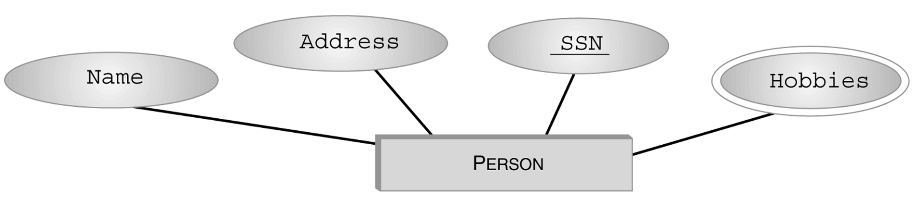
Entity Type (con’t)
Graphical Representation in E-R diagram:
Set valued

Slide 6
Relationships
Relationship: relates two or more entities
John majors in Computer Science
Relationship Type: set of similar relationships
Student (entity type) related to Department (entity type) by MajorsIn (relationship type).
Distinction:
relation (relational model) - set of tuples
relationship (E-R Model) – describes relationship between entities of an enterprise
Both entity types and relationship types (E-R model) may be represented as relations (in the relational model)

Slide 7
Attributes and Roles
Attribute of a relationship type describes the relationship
e.g., John majors in CS since 2000
John and CS are related
2000 describes relationship - value of SINCE attribute of MajorsIn relationship type
Role of a relationship type names one of the related entities
e.g., John is value of Student role, CS value of Department role of MajorsIn relationship type
(John, CS; 2000) describes a relationship

Slide 8
Relationship Type
Described by set of attributes and roles
e.g., MajorsIn: Student, Department, Since
Here we have used as the role name (Student) the name of the entity type (Student) of the participant in the relationship, but ...

Slide 9
Roles
Problem: relationship can relate elements of same entity type
e.g., ReportsTo relationship type relates two elements of Employee entity type:
Bob reports to Mary since 2000
We do not have distinct names for the roles
It is not clear who reports to whom

Slide 10
Roles (con’t)
Solution: role name of relationship type need not be same as name of entity type from which participants are drawn
ReportsTo has roles Subordinate and Supervisor and attribute Since
Values of Subordinate and Supervisor both drawn from entity type Employee

Slide 11
Schema of a Relationship Type
Role names, R_{i}, and their corresponding entity sets. Roles must be single valued (number of roles = degree of relationship)
Attribute names, A_{j}, and their corresponding domains. Attributes may be set valued
Key: Minimum set of roles and attributes that uniquely identify a relationship
Relationship: <e₁, …e_{n}; a₁, …a_{k}>
e_{i} is an entity, a value from R_{i}’s entity set
a_{j} is a set of attribute values with elements from domain of A_{j}

Slide 12
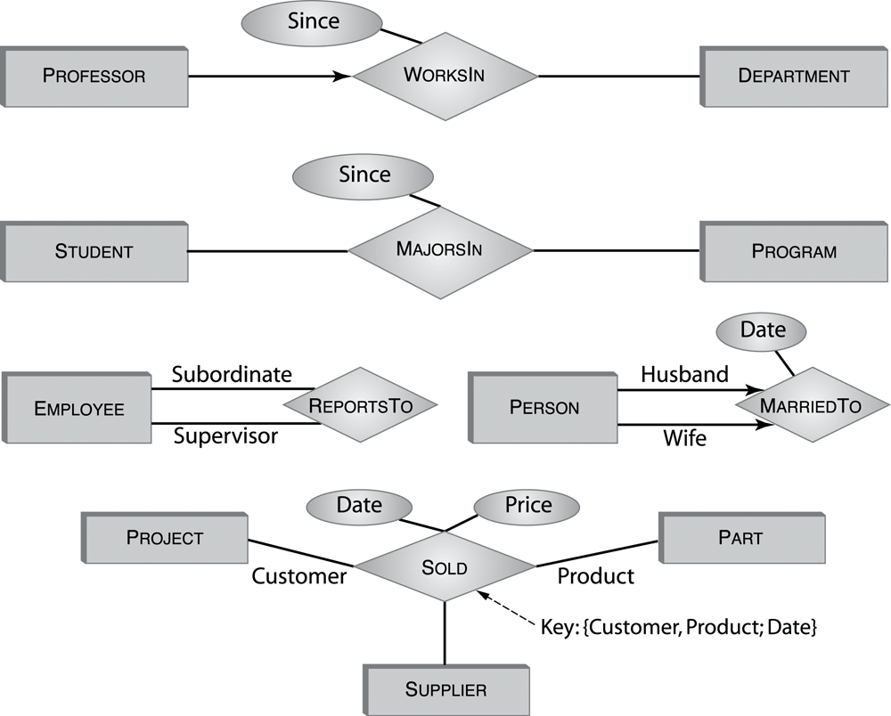
Graphical Representation
Roles are edges labeled with role names (omitted if role name = name of entity set). Most attributes have been omitted.

Slide 13
Single-role Key Constraint
If, for a particular participant entity type, each entity participates in at most one relationship, corresponding role is a key of relationship type
E.g., Professor role is unique in WorksIn
Representation in E-R diagram: arrow
Many to One
1..n 0..1
Professor
WorksIn
Department

Slide 14
Entity Type Hierarchies
One entity type might be subtype of another
Freshman is a subtype of Student
A relationship exists between a Freshman entity and the corresponding Student entity
e.g., Freshman John is related to Student John
This relationship is called IsA
Freshman IsA Student
The two entities related by IsA are always descriptions of the same real-world object

Slide 15
IsA
Student
Represents 4
relationship types
IsA
Freshman
Sophmore
Junior
Senior

Slide 16
Properties of IsA
Inheritance - Attributes of supertype apply to subtype.
E.g., GPA attribute of Student applies to Freshman
Subtype inherits all attributes of supertype.
Key of supertype is key of subtype
Transitivity - Hierarchy of IsA
Student is subtype of Person, Freshman is subtype of Student, so Freshman is also a subtype of Person

Slide 17
Advantages of IsA
Can create a more concise and readable E-R diagram
Attributes common to different entity sets need not be repeated
They can be grouped in one place as attributes of supertype
Attributes of (sibling) subtypes can be different

Slide 18
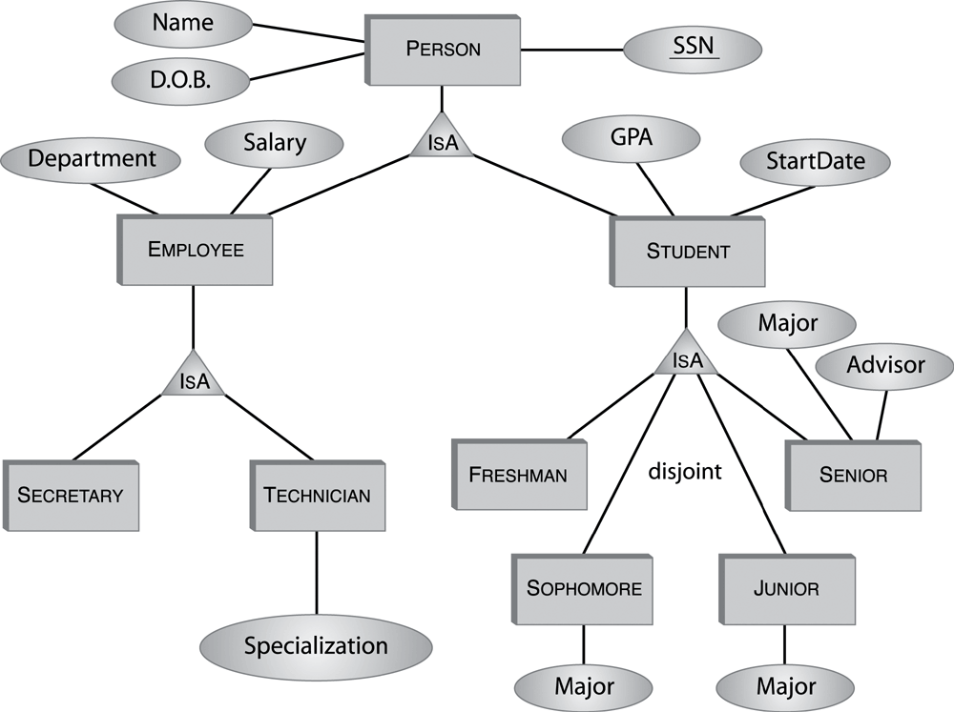
IsA Hierarchy - Example

Slide 19
Constraints on Type Hierarchies
Might have associated constraints:
Covering constraint: Union of subtype entities is equal to set of supertype entities
Employee is either a secretary or a technician (or both)
Disjointness constraint: Sets of subtype entities are disjoint from one another
Freshman, Sophomore, Junior, Senior are disjoint set

Slide 20
Participation Constraint
If every entity participates in at least one relationship, a participation constraint holds:
A participation constraint of entity type E having role ρ in relationship type R states that for e in E there is an r in R such that ρ(r) = e.
e.g., every professor works in at least one department
Many to Many
1..n 1..n
Professor
WorksIn
Department

Slide 21
Participation and Key Constraint
If every entity participates in exactly one relationship, both a participation and a key constraint hold:
e.g., every professor works in exactly one department
Many to one
1..n 1..1
Professor
WorksIn
Department
E-R representation: thick line

Slide 22
Representation of Entity Types in the Relational Model
An entity type corresponds to a relation
Relation’s attributes = entity type’s attributes
Problem: entity type can have set valued attributes, e.g.,
Person: Id, Name, Address, Hobbies
Solution: Use several rows to represent a single entity
(111111, John, 123 Main St, stamps)
(111111, John, 123 Main St, coins)
Problems with this solution:
Redundancy
Key of entity type (Id) not key of relation
Hence, the resulting relation must be further transformed (Chapter 6)

Slide 23
Representation of Relationship Types in the Relational Model
Typically, a relationship becomes a relation in the relational model
Attributes of the corresponding relation are
Attributes of relationship type
For each role, the primary key of the entity type associated with that role
Example:
S2000Courses (CrsCode, SectNo, Enroll)
Professor (Id, DeptId, Name)
Teaching (CrsCode, SecNo, Id, RoomNo, TAs)
SectNo
CrsCode
Enroll
RoomNo
DeptId
Name
Teaching
S2000Courses
Professor
TAs
Id

Slide 24
Representation of Relationship Types in the Relational Model
Candidate key of corresponding table = candidate key of relation
Except when there are set valued attributes
Example: Teaching (CrsCode, SectNo, Id, RoomNo, TAs)
Key of relationship type = (CrsCode, SectNo)
Key of relation = (CrsCode, SectNo, TAs)
Set valued
CrsCode SectNo Id RoomNo TAs
CSE305 1 1234 Hum 22 Joe
CSE305 1 1234 Hum 22 Mary

Slide 25
Representation in SQL
Each role of relationship type produces a foreign key in corresponding relation
Foreign key references table corresponding to entity type from which role values are drawn

Slide 26
Example 1
Since
Status
WorksIn
Professor
Department
CREATE TABLE WorksIn (
Since DATE, -- attribute
Status CHAR (10), -- attribute
ProfId INTEGER, -- role (key of Professor)
DeptId CHAR (4), -- role (key of Department)
PRIMARY KEY (ProfId), -- since a professor works in at most one department
FOREIGN KEY (ProfId) REFERENCES Professor (Id),
FOREIGN KEY (DeptId) REFERENCES Department )

Slide 27
Example 2
Date
Price
Sold
Project
Part
Supplier
CREATE TABLE Sold (
Price INTEGER, -- attribute
Date DATE, -- attribute
ProjId INTEGER, -- role
SupplierId INTEGER, -- role
PartNumber INTEGER, -- role
PRIMARY KEY (ProjId, SupplierId, PartNumber, Date),
FOREIGN KEY (ProjId) REFERENCES Project,
FOREIGN KEY (SupplierId) REFERENCES Supplier (Id),
FOREIGN KEY (PartNumber) REFERENCES Part (Number) )

Slide 28
Representation of Single Role Key Constraints in the Relational Model
Relational model representation: key of the relation corresponding to the entity type is key of the relation corresponding to the relationship type
Id is primary key of Professor; ProfId is key of WorksIn. Professor 4100 does not participate in the relationship.
Cannot use foreign key in Professor to refer to WorksIn since some professors may not work in any dept. (But ProfId is a foreign key in WorksIn that refers to Professor.)
Professor
WorksIn
Department
Id
ProfId
1123
4100
3216
Key
1123 CSE
3216 AMS
Professor
WorksIn

Slide 29
Representing Type Hierarchies in the Relational Model
Supertypes and subtypes can be realized as separate relations
Need a way of identifying subtype entity with its (unique) related supertype entity
Choose a candidate key and make it an attribute of all entity types in hierarchy

Slide 30
Type Hierarchies and the Relational Model
Translated by adding the primary key of supertype to all
subtypes. Plus foreign key from subtypes to the supertype.
Id attribs0
Student
Id attribs1 Id attribs2 Id attribs3 Id attribs4
Freshman Sophmore Junior Senior
FOREIGN KEY Id REFERENCES Student
in Freshman, Sophomore, Sunior, Senior

Slide 31
Type Hierarchies and the Relational Model
Redundancy eliminated if IsA is not disjoint
For individuals who are both employees and students, Name and DOB are stored only once
Person
Employee Student
SSN Name DOB SSN Department Salary SSN GPA StartDate
1234 Mary 1950 1234 Accounting 35000 1234 3.5 1997

Slide 32
Type Hierarchies and the Relational Model
Other representations are possible in special cases, such as when all subtypes are disjoint
See in the book

Slide 33
Representing Participation Constraints in the Relational Model
Professor
WorksIn
Department
Inclusion dependency: Every professor works in at least one dep’t.
in the relational model: (easy)
Professor (Id) references WorksIn (ProfId)
in SQL:
Simple case: If ProfId is a key in WorksIn (i.e., every professor works in exactly one department) then it is easy:
FOREIGN KEY Id REFERENCES WorksIn (ProfId)
General case – ProfId is not a key in WorksIn, so can’t use foreign key constraint (not so easy):
CREATE ASSERTION ProfsInDepts
CHECK ( NOT EXISTS (
SELECT * FROM Professor P
WHERE NOT EXISTS (
SELECT * FROM WorksIn W
WHERE P.Id = W.ProfId ) ) )

Slide 34
Representing Participation Constraint in the Relational Model
Example (can’t use foreign key in Professor if ProfId is not a candidate key in WorksIn)
ProfId
Id
1123 CSE
1123 AMS
4100 ECO
3216 AMS
1123
4100
3216
Professor
WorksIn
ProfId not a
candidate key

Slide 35
Representing Participation and Key Constraint in SQL
If both participation and key constraints apply, use foreign key constraint in entity table (but beware: if candidate key in entity table is not primary, presence of nulls violates participation constraint).
CREATE TABLE Professor (
Id INTEGER,
……
PRIMARY KEY (Id), -- Id can’t be null
FOREIGN KEY (Id) REFERENCES WorksIn (ProfId)
--all professors participate
)
Professor
WorksIn
Department

Slide 36
Participation and Key Constraint in the Relational Model
Example:
Id
ProfId
xxxxxx 1123
yyyyyy 4100
zzzzzzz 3216
1123 CSE
4100 ECO
3216 AMS
Professor
WorksIn

Slide 37
Participation and Key Constraint in Relational Model (again)
Alternative solution if both key and participation constraints apply: merge the tables representing the entity and relationship sets
Since there is a 1-1 and onto relationship between the rows of the entity set and the relationship sets, might as well put all the attributes in one table

Slide 38
Participation and Key Constraint in Relational Model
Example
Name Id DeptId
xxxxxxx 1123 CSE
yyyyyyy 4100 ECO
zzzzzzzz 3216 AMS
Prof_WorksIn

Slide 39
Entity or Attribute?
Sometimes information can be represented as either an entity or an attribute.
Transcript
Student
Semester
Grade
Course
Semester
Appropriate if Semester has attributes
(next slide)
Transcript
Student
Grade
Course

Slide 40
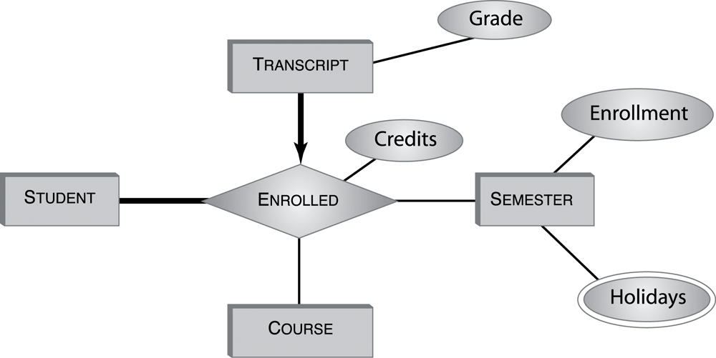
Entity or Relationship?

Slide 41
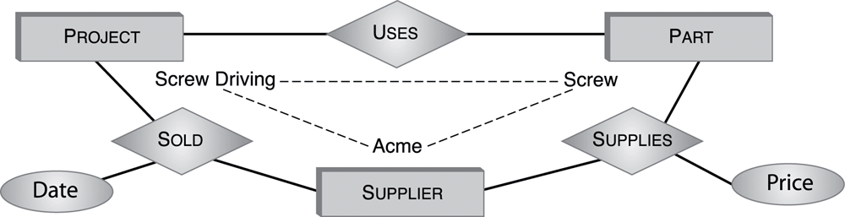
(Non-) Equivalence of Diagrams
Transformations between binary and ternary relationships.
Part
Date
Project
Sold
Price
Supplier
Information loss?
Navigation Trap

